Slide 1

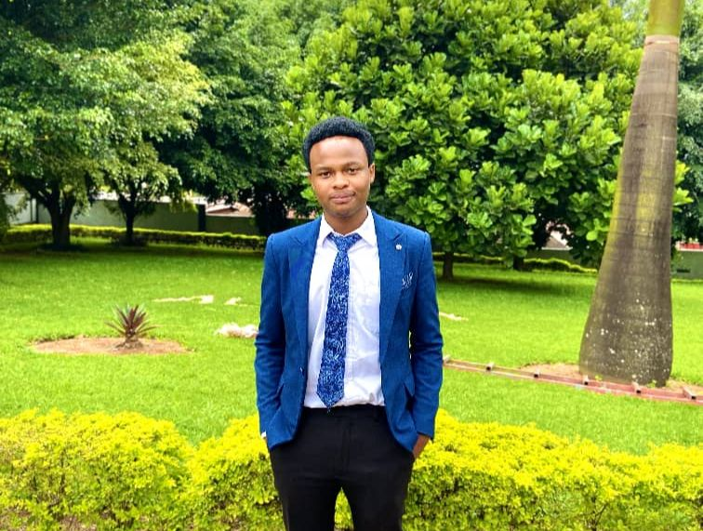

Name: IRIMASO MUCYO Titus
https://www.linkedin.com/in/titus-mucyo-b6b70a284/ Specialization: IT & Software Engineering Year of Study: Second Year Address: Kigali-Rwanda Use of Digital information:Digital tools enhance productivity by providing quick access to research resources, organizing notes,
managing time with calendars and to-do lists, and enabling communication and collaboration through apps like Google Workspace. They also support continuo- us learning through online courses and tutorials. Expectation to the course: From the PL/SQL course, I hope to learn how to write efficient queries, create stored procedures and triggers, and manage data- base effectively to enhance my problem solving skills for real world database scenarios. What they don’t know about me: is that i like singing and playing Piano.

